Slide 1
Team Ink3D Test Plan Review
Daniel Lain
Tim Edmonson
Shawn Simonson
Jesse Bowles

Slide 2
Outline
Requirements Overview
Architecture Overview
Detail Design Overview
Test Items
Risks
Features To Be Tested
Features Not Tested
Test Deliverables
Test Schedule

Slide 3
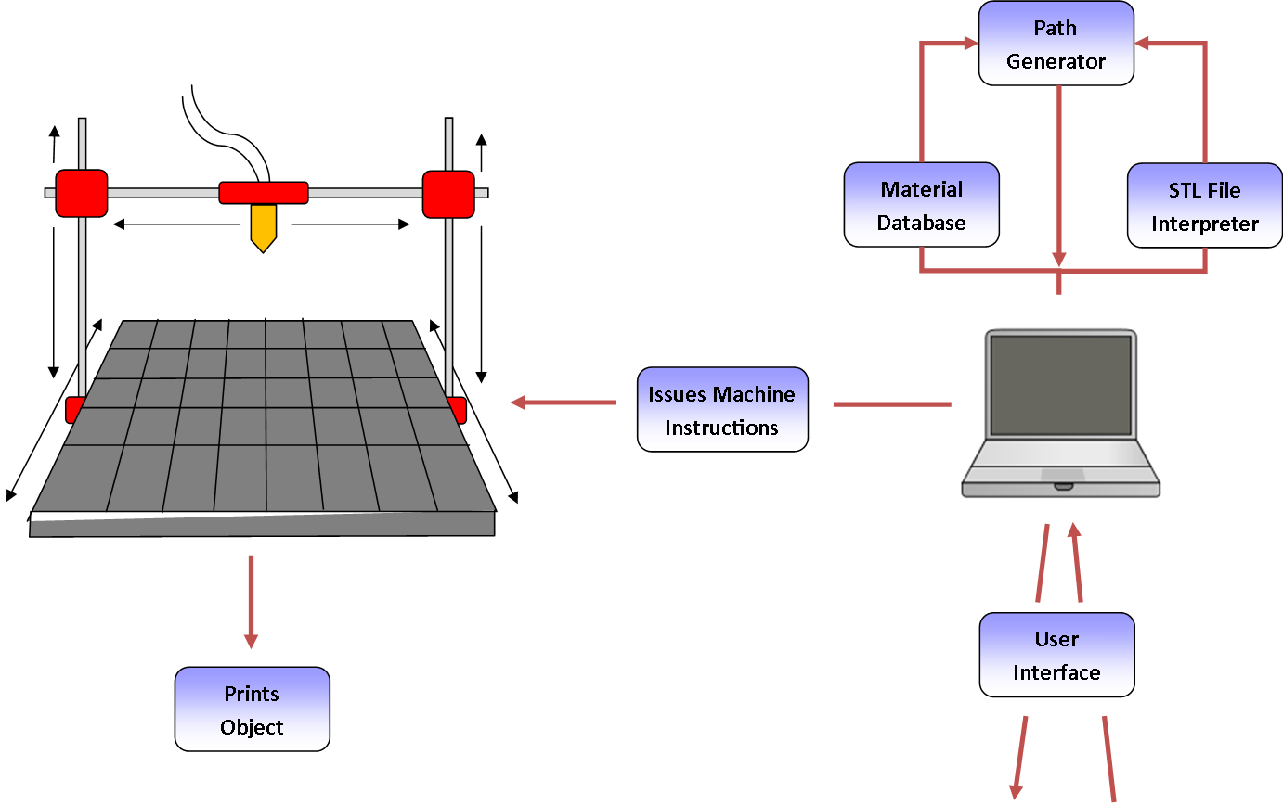
Architecture Overview
Configurability
Modularity
Expandability
Portability
Multiple Materials

Slide 4
Architecture Design
Seven Layers
Layer Independence
Interface Based
Master Configuration Object

Slide 5
Module Decomposition
High Cohesion
Low Coupling
Master Configuration Object

Slide 6
Module Data Flows
Layer | Data Flow ID | Data
Outside Inputs | OI1 | Object file of the STL file to be printed
 | OI2 | Printer configuration data entry values
 | OI3 | Material configuration data entry values
 | OI4 | Print configuration data entry values
 | OI5 | Print selections and button press
 | OI6 | Pause, resume, and stop button Presses
 | OI7 | Disk reads of XML and Directory structure
 | OI8 | Printer state information
 | OI9 | OS Driver information
 | OI10 | Extruder configuration data entry values
User Interface Layer | UI1 | Import file name
 | UI2 | Success state of import
 | UI3 | Loaded printer configuration
 | UI4 | Save printer configuration request
 | UI5 | Save material configuration request
 | UI6 | Loaded material configuration
 | UI7 | Loaded print configuration
 | UI8 | Save print configuration request
 | UI9 | Loaded configuration data
 | UI10 | Run print job
 | UI11 | Pause, resume, and stop button Presses
 | UI12 | Printer state information
 | UI13 | File Configuration object
 | UI14 | Printer configuration object
 | UI15 | Material configuration object
 | UI16 | Print Configuration object
 | UI17 | All requested configuration objects
 | UI18 | Object save/load requests
 | UI19 | Object save/load results
 | UI20 | XML File writes to disk
 | UI21 | Save print job configuration
 | UI22 | Print package object
 | UI23 | Print, Pause, Resume request
 | UI24 | Loaded Extruder Configuration Data
 | UI25 | Save Extruder Configuration Request
 | UI26 | Extruder Configuration Object
Preprocessing Layer | PR1 | Print package object
 | PR2 | Print package object
Processing Layer | PO1 | Print package object
Post-Processing Layer | PP1 | Print package object
 | PP2 | Print package object
Printer Control Layer | PL1 | G-Code
Communications Layer | CL1 | Serialized G-Codes
 | CL2 | Serialized printer state
 | CL3 | Command stream
Printer Feedback Layer | PF1 | Printer State Object
 | PF2 | Printer State Object
Many GUI Exchanges
Very Little In Processing

Slide 7
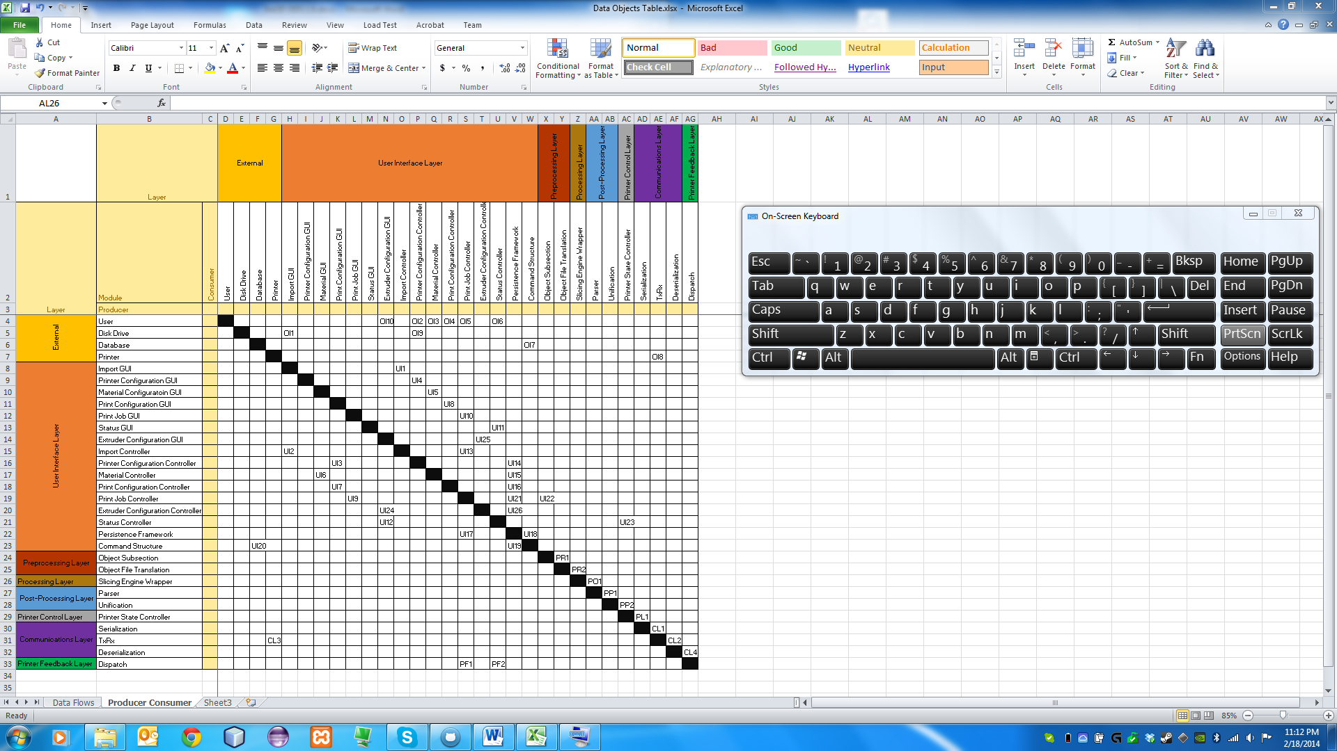
Producer Consumer Table
Many GUI Exchanges
Very Little In Processing

